Slide 1

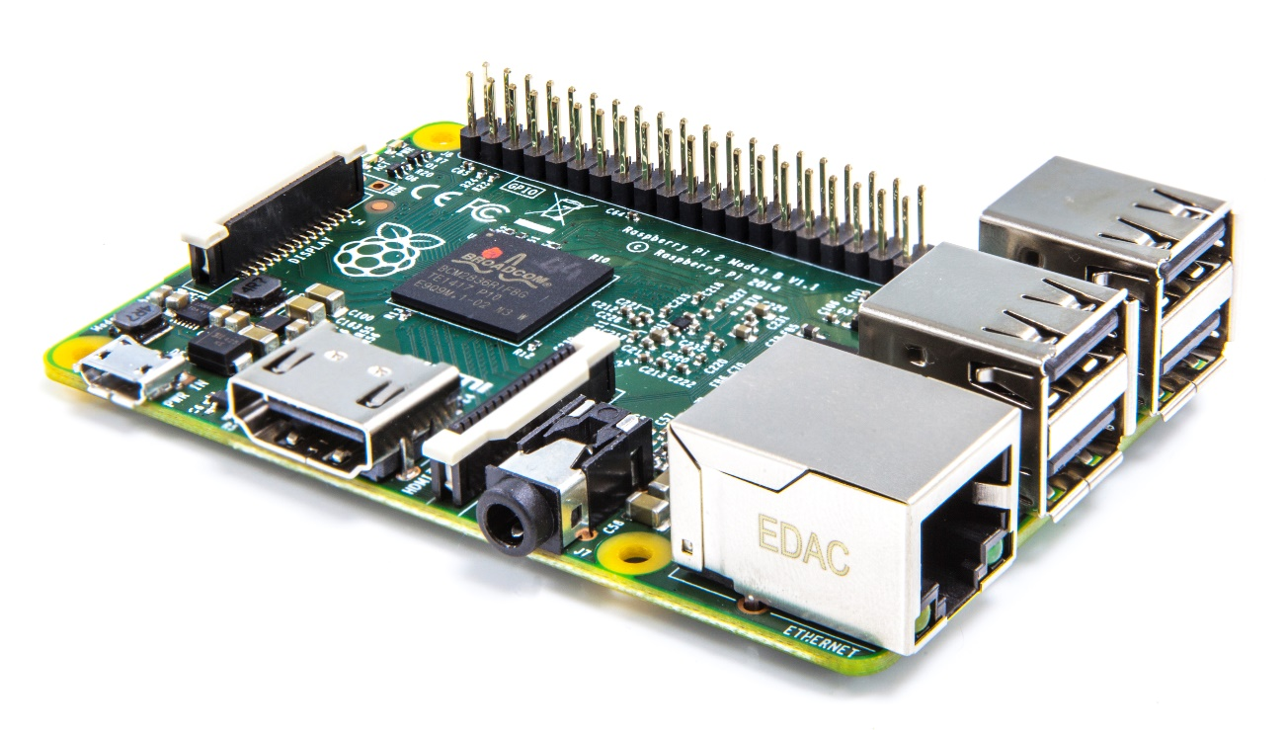
.NET on Embedded Devices
Presented by
Mario Di Vece
Geovanni Perez

Slide 2
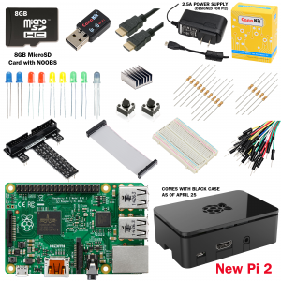
Hardware
Raspberry Pi 2
WiFi Dongle
USB Keyboard
HDMI cable and Monitor
Camera Module
USB Micro-B Power Supply (Wall Adapter or Cable)
Micro SD Card Reader
Micro SD Card (Class 10, 8 GB recommended)
Assorted Resistors and LEDs
Cobbler
Tip: The CanaKit RPi2 Ultimate Starter Kit comes with everything you need for under $100USD

Slide 3

Software
Windows 7 or above
Visual Studio 2015 (Community is more than enough)
PuTTY
Git or Subversion client
Raspbian Jessie (http://raspberrypi.org/downloads)
Win32 Disk Imager (http://sourceforge.net/projects/win32diskimager/)

Slide 4
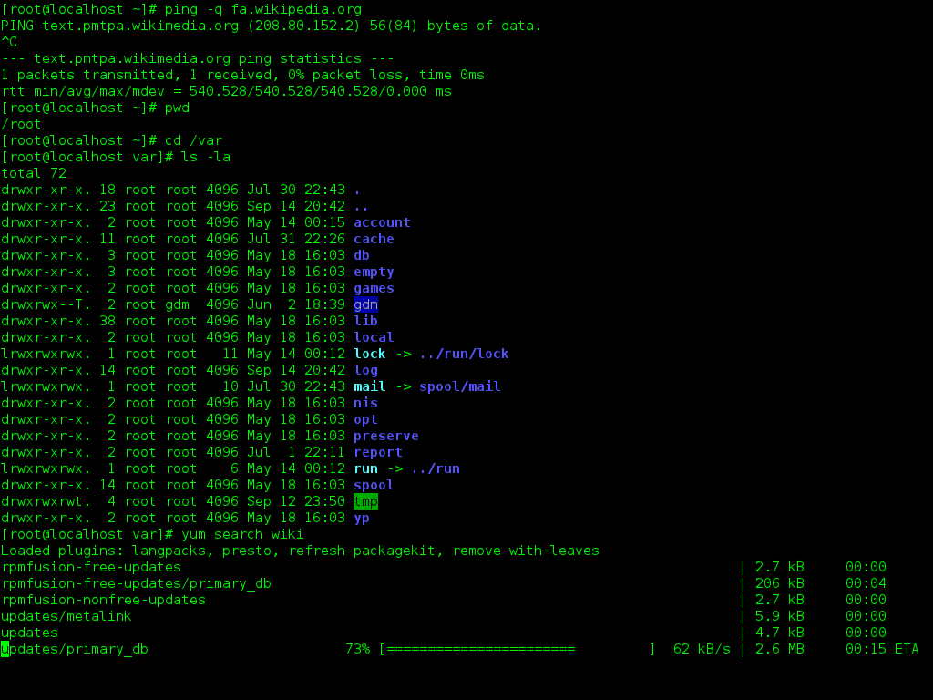
Setup the Pi
Burn the image file onto the Micro SD card
Connect WiFi dongle, USB Keyboard and HDMI monitor
Plug in the power supply and watch it boot
Open a console window and run sudo raspi-config
Expand Filesystem, enable camera, B2 Boot Option, Disable Overscan, enable SSH
sudo reboot
sudo nano /etc/network/interfaces
Modify iface wlan0 inet manual to iface wlan0 inet auto
sudo nano /etc/wpa_aupplicant/wpa_supplicant.conf
network = { ssid=“example” psk=“abcdefg” }
sudo reboot

Slide 5
Connect to the Pi
hostname –I
Note down the IP Address
Back on your dev machine …
Fire up PuTTY and connect to the Pi via SSH
sudo apt-get update
sudo apt-get upgrade
sudo apt-get install mono-complete
This takes a few minutes
git clone git://git.drogon.net/wiringPi
cd wiringPi
./build

Slide 6
What we just did…
Loaded the OS
Configured the Pi
Connected to the Internet
Upgraded the OS
Added Mono (.NET), and compiled WiringPi

Slide 7
Let’s Code!
http://github.com/unosquare
Get a copy of sshdeploy and compile it using VS 2015
This will allows us to perform CI on the device
Get a copy of tubular-boilerplate
This will give us a good starting point for our Web App
Create a new Console Application (4.5)
Add the following NuGet Packages:
Install-Package EmbedIO
Install-Package Tubular

Slide 8
DEMO

Slide 9
What we learned today…
Using inexpensive hardware:
We looked at physical computing with high-level languages
We realized that mono also runs on ARM devices
We used open source software to quickly build a good-looking application on a credit-card sized device

Slide 10
Comments and Questions
http://github.com/unosquare
Get a copy of what we just did:
https://github.com/unosquare/unolabs-pi
Check out our projects:
http://unosquare.github.io

